Slide 1



Noida Institute of Engineering and Technology, Greater Noida
Society , State and Polity in India
Unit:1
Subject Name
INDIAN TRADITIONS, CULTURE AND SOCIETY
Pooja Tyagi
Department of MBA
Course Details
CS 6th Semester

Slide 2
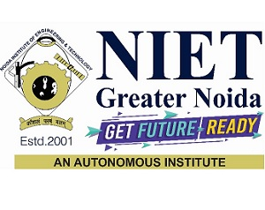

Faculty Introduction
Pursuing Ph.D. from CCS University, Meerut under COMMERCE
Area of Research- Marketing
Done MBA, M.com , MA(Economics),B.com
Specialization- Marketing & Finance
Qualified UGC-NET
10+ years of Experience in teaching

Slide 3
Index/ Content
S. No. | Index
1. | Name of Subject with code, Course and Subject Teacher
2. | Brief Introduction of Faculty member with Photograph
3. | Evaluation Scheme
4. | Syllabus
5. | Branch wise Application
6. | Course Objective(s)
7. | Course Outcome(s)
8. | Program Outcomes (POs)
9. | Cos and POs Mapping

Slide 4
Index/ Content
S. No. | Index
10. | Program Specific Outcomes (PSOs)
11. | COs and PSOs Mapping
12. | Program Educational Objectives (PEOs)
13. | Result Analysis
14. | End Semester Question paper Templates
15. | Prerequisite/Recap
16. | Brief Introduction about the subject with Video links
17. | Unit Contents
18. | Unit Objectives
19. | Topic/ Session Objectives

Slide 5
Index/ Content
S. No. | Index
20. | Lecture related to topic
21. | Daily Quiz
22. | Weekly Assignment
23. | Topic Links
24. | MCQs
25. | Glossary questions
26. | Old question papers
27. | Expected questions
28. | Recap of Unit

Slide 6
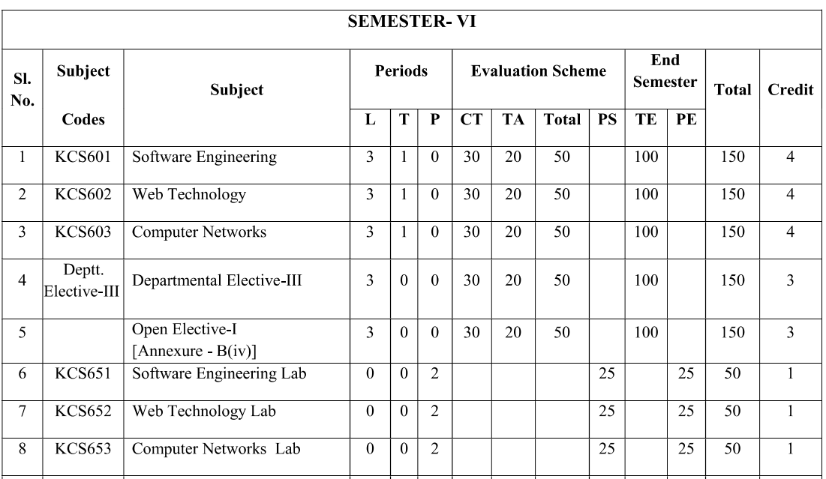
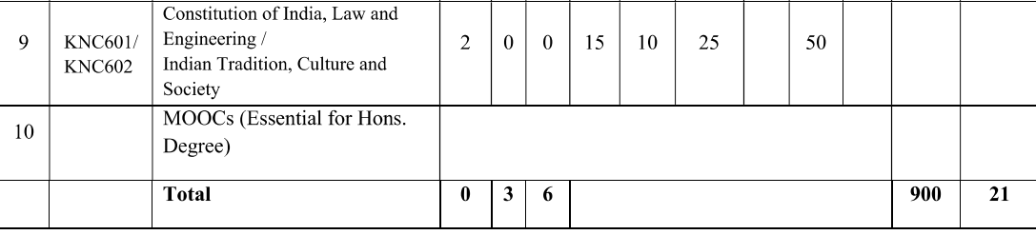
Evaluation Scheme

Slide 7
Syllabus
UNIT I: Society State and Polity in India (6 Hours)
State in Ancient India: Evolutionary Theory, Force Theory, Mystical Theory Contract Theory, Stages of State Formation in Ancient India, Kingship , Council of Ministers Administration Political Ideals in Ancient India Conditions’ of the Welfare of Societies, The Seven Limbs of the State, Society in Ancient India, Purusārtha, Varnāshrama System, Āshrama or the Stages of Life, Marriage, Understanding Gender as a social category, The representation of Women in Historical traditions, Challenges faced by Women. Four-class Classification, Slavery.
UNIT II- Indian Literature, Culture, Tradition, and Practices (6 Hours)
Evolution of script and languages in India: Harappan Script and Brahmi Script. The Vedas, the Upanishads, the Ramayana and the Mahabharata, Puranas, Buddhist And Jain Literature in Pali,Prakrit And Sanskrit, Kautilya’s Arthashastra, Famous Sanskrit Authors, Telugu Literature, Kannada Literature,Malayalam Literature ,Sangama Literature Northern Indian Languages & Literature, Persian And Urdu ,Hindi Literature

Slide 8
Syllabus
UNIT III: Indian Religion, Philosophy, and Practices (8 Hour)
Pre-Vedic and Vedic Religion, Buddhism, Jainism, Six System Indian Philosophy, Shankaracharya, Various Philosophical Doctrines, Other Heterodox Sects, Bhakti Movement, Sufi movement, Socio religious reform movement of 19th century, Modern religious practices.
UNIT IV: Science, Management and Indian Knowledge System (8 Hour)
Astronomy in India, Chemistry in India, Mathematics in India, Physics in India, Agriculture in India, Medicine in India,Metallurgy in India, Geography, Biology, Harappan Technologies, Water Management in India, Textile Technology in India,Writing Technology in India Pyrotechnics in India Trade in Ancient India/India’s Dominance up to Pre-colonial Times.
UNIT V: Cultural Heritage and Performing Arts (4 Hours)
Indian Architect, Engineering and Architecture in Ancient India, Sculptures, Seals, coins, Pottery, Puppetry, Dance, Music, Theatre, drama, Painting, Martial Arts Traditions, Fairs and Festivals, Current developments in Arts and Cultural, Indian’s Cultural Contribution to the World. Indian Cinema

Slide 9
Branch wise Applications
This course will help-
To know about the Indian culture and related education and to apply in society.
To understand the importance of Indian heritage, languages etc. and spread the knowledge in the society.
To understand the different religions, dialects, living standards of the people and make aware the society about the same

Slide 10
Course Objectives
Students will be able to understand the basic knowledge about the Society State and Polity in India.
Students will be able to understand the basic knowledge about the Indian Literature, Culture, Tradition, and Practices .
Help the students in acquiring the knowledge of Indian Religion, Philosophy, and Practices .
Aware the students about the Science, Management and Indian Knowledge System .
Aware the students about the Cultural Heritage and Performing Arts .

Slide 11
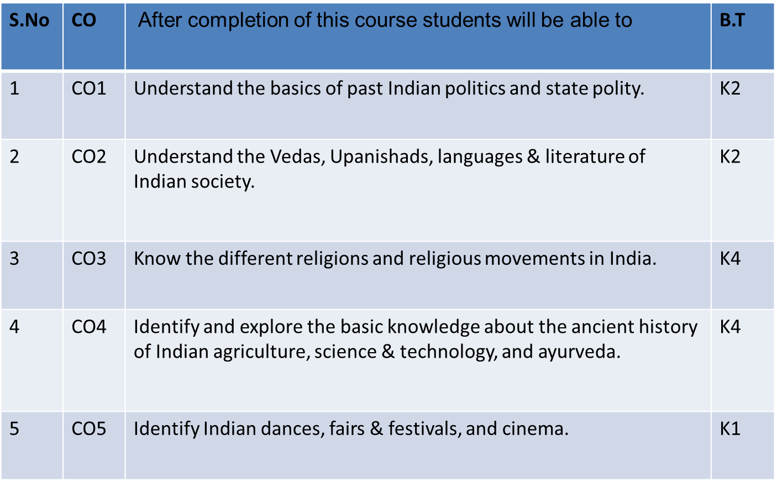
Course Outcomes

Slide 12
Program Outcomes
1. Engineering knowledge: Apply the knowledge of mathematics, science, engineering fundamentals, and an engineering specialization to the solution of complex engineering problems.
2. Problem analysis: Identify, formulate, review research literature, and analyze complex engineering problems reaching substantiated conclusions using first principles of mathematics, natural sciences, and engineering sciences.
3. Design/development of solutions: Design solutions for complex engineering problems and design system components or processes that meet the specified needs with appropriate consideration for the public health and safety, and the cultural, societal, and environmental considerations.
4. Conduct investigations of complex problems: Use research-based knowledge and research methods including design of experiments, analysis and interpretation of data, and synthesis of the information to provide valid conclusions.

Slide 13
Program Outcomes
5. Modern tool usage: Create, select, and apply appropriate techniques, resources, and modern engineering and IT tools including prediction and modeling to complex engineering activities with an understanding of the limitations.
6. The engineer and society: Apply reasoning informed by the contextual knowledge to assess societal, health, safety, legal and cultural issues and the consequent responsibilities relevant to the professional engineering practice.
7. Environment and sustainability: Understand the impact of the professional engineering solutions in societal and environmental contexts, and demonstrate the knowledge of, and need for sustainable development.
8. Ethics: Apply ethical principles and commit to professional ethics and responsibilities and norms of the engineering practice.

Slide 14
Program Outcomes
9. Individual and team work: Function effectively as an individual, and as a member or leader in diverse teams, and in multidisciplinary settings.
10. Communication: Communicate effectively on complex engineering activities with the engineering community and with society at large, such as, being able to comprehend and write effective reports and design documentation, make effective presentations, and give and receive clear instructions.
11. Project management and finance: Demonstrate knowledge and understanding of the engineering and management principles and apply these to one’s own work, as a member and leader in a team, to manage projects and in multidisciplinary environments.
12. Life-long learning: Recognize the need for, and have the preparation and ability to engage in independent and life-long learning in the broadest context of technological change.

Slide 15
CO-PO Mapping
PO CO | PO 1 | PO2 | PO3 | PO 4 | PO 5 | PO 6 | PO 7 | PO 8 | PO 9 | PO 10 | PO 11 | PO 12
CO 1 | M |  |  | M |  |  |  |  |  |  |  | M
CO 2 |  |  |  |  |  |  | H | M |  |  |  | H
CO 3 |  | M |  |  |  |  |  | H |  |  |  | M
CO 4 |  |  |  |  |  |  |  |  | M |  |  | H
CO 5 |  |  |  |  |  |  | M
Avg. | 2 | 2 |  | 2 |  |  | 2.5 | 2.5 | 2 |  |  | 2.5

Slide 16
Program Specific Outcomes
S.NO. | Program Specific Outcomes | PSO Description
1 | PSO1 | Ability to design manufacturing processes, products, the equipment, tooling and necessary environment for the manufacture of products that meet specific material and other requirements.
2 | PSO2 | Ability to use design, manufacturing and industrial engineering software packages to formulate and solve real time issues.
3 | PSO3 | Ability to analyze, synthesis and control manufacturing operations using statistical methods and to create competitive advantage through the application of manufacturing planning, strategy, quality and control concepts.

Slide 17
Program Educational Objectives
PEO1: able to apply sound knowledge in the field of information technology to fulfill the needs of IT industry.
PEO2: able to design innovative and interdisciplinary systems through latest digital technologies.
PEO3: able to inculcate professional and social ethics, team work and leadership for serving the society.
PEO4: able to inculcate lifelong learning in the field of computing for successful career in organizations and R&D sectors.

Slide 18
Result Analysis
It will be done after result declaration.

Slide 19
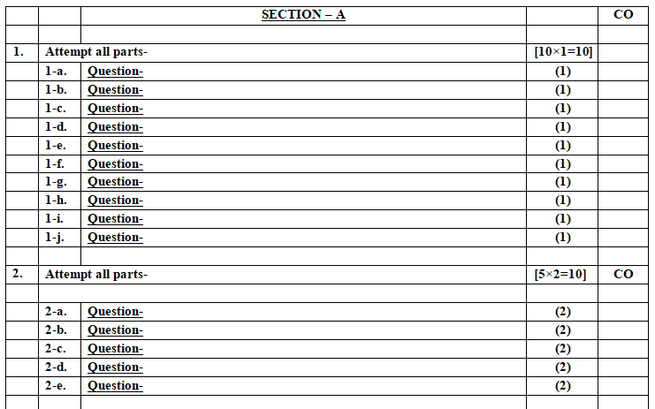
End Semester Question Paper Template

Slide 20
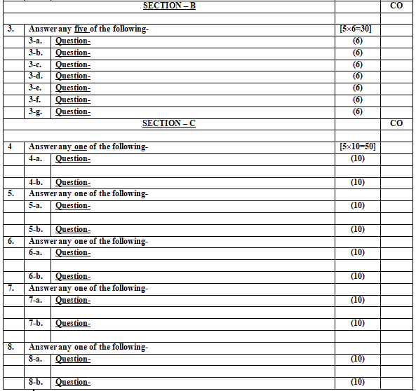
End Semester Question Paper Template

Slide 21
Pre requisites
Students should have a basic understanding of the Indian traditions, culture and the states.

Slide 22
Introduction of subject with video links
Introduction: EITK is the study of Indian culture, society, as well as different languages and the living standards of the Indian people, and it helps to understand the history of culture and society in different regions of the country.
Video Links:
https://youtu.be/X2SXJiSv3R4
https://youtu.be/7PuuAgeSRpU
https://youtu.be/RVT60SA3KgM
https://youtu.be/dK53fX97jlc

Slide 23
Content
Introduction to ancient India
Evolution of Theories
Ancient States of India
Administration of ancient India

Slide 24
Unit Objective(s)
To make students aware about ancient Indian states
To develop a clear understanding on different ashrams in life.
To explain ancient Indian administration to the students.

Slide 25
Topic Mapping with course outcomes
Unit-I | So. No. | Mapping
 |  | Topic | Course Outcomes
I | 1 | Introduction to ancient India | Co1
 | 2 | Ancient Indian states | Co1
 | 3 | Ancient Indian administration | CO1

Slide 26
Topic objectives
Students will be able to know the following concepts:
Introduction to ancient Indian states
Introduction to ancient Indian administration
Introduction to ancient Indian culture

Slide 27
Definition of State
A state is a polity under a system of governance with a monopoly on force. There is no undisputed definition of a state. A widely used definition from the German sociologist Max Weber is that a "state" is a polity that maintains a monopoly on the legitimate use of violence.
Aristotle defined the State as a “union of families and villages having for its end a perfect and self – sufficing life by which it meant a happy and honorable life”.
According to Sidgwick. “State is a combination or association of persons in the form of government and governed and united together into a politically organised people of a definite territory.”

Slide 28
States in Ancient India
The state in ancient India was considered necessary, for it ensures peace, order and happiness. It was a social organization with political power. However, ancient scholars were not unanimous in their opinion with regard to the origin of the state.
According to some, state was the outcome of a contract mainly political in nature between the rulers and the ruled.
They opine that prior to the origin of state there was something called a golden age, wherein the people enjoyed a life of peace, order, self-discipline and happiness. Similarly, several theories like force theory, patriarchal theory, matriarchal theory, divine origin theory and finally the evolutionary theory advanced the origin of the state.

Slide 29
Theories of Origin of States
1. The Evolutionary Theory
This theory is formed on the principle that the state was an evolution of the family, becoming more and more complex as the family grew.
2. The Force Theory
This theory is based upon the idea that a government arose when the people of an area were brought under the authority of one person or group.
3. The Divine Right Theory
This theory is based on the notion that a god or multiple gods chose certain people to rule a civilization or group of people.
4. The Social Contract Theory
This theory was created in the 1600s when the Europeans challenged sovereign rulers. Those people were backed up by philosophers that believed the origin of the state was in a social contract.

Slide 30
Evolutionary theory
According to evolutionary theory, government originates from a family or clan-bound structure, which can explain the formation of the world's first political structures.
These earliest and very loosely formed governments were the result of a shift from hunter-gatherer societies to more settled agricultural societies.
As families joined to form clans and clans joined to form villages, the need for leaders and a central organizational structure developed.
These leaders helped determine how to address still unfamiliar issues, such as water rights for crop irrigation and the distribution of other resources.
They also provided an increased sense of safety and security for the society. In many early societies, these first states developed monarchies, with rule based on membership in a ruling family.
In modern times, some governments continue to be led by a succession of members from the same family.

Slide 31
Force theory
This theory proposes that the origin of state is developed through the use of force. One person or a small group of people claim control over the population in a specific area by force. Once the rule is well established the state is established. This theory is generally a result of war.
The force or might prevailed over the right in the primitive society. A man physically stronger established his authority over the less strong persons. The strongest person in a tribe is, therefore, made the chief or leader of that tribe.

Slide 32
Social Contract theory
The most famous theory with regard to the origin of the state is the social contract theory. The theory goes to tell that the state came into existence out of a contract between the people and the sovereign at some point of time.
According to this theory, there were two divisions in human history – one period is prior to the establishment of the state called the “state of nature” and the other period is one subsequent to the foundation of the state called the “civil society”. The state of nature was benefit of society, government and political authority. There was no law to regulate the relations of the people in the state of nature.

Slide 33
Mystical theory/ Divine right theory
Mysticism is popularly known as becoming one with God or the Absolute, which is given a religious or spiritual meaning. It may also refer to the attainment of insight in ultimate or hidden truths, and to human transformation supported by various practices and experiences.
The oldest theory about the origin of the state is the divine origin theory. It is also known as the theory of divine right of Kings.
The exponents of this theory believe that the state did not come into being by any effort of man. It is created by God.
The King who rules over the state is an agent of God on earth.
The King derives his authority from God and for all his actions he is responsible to God alone. Obedience to the King is ordained to God and violation of it will be a sin. The King is above law and no subject has any right to question his authority or his action. The King is responsible of God alone.

Slide 34
Daily Quiz
The oldest theory about the origin of the state is the ______.
The state of ______ was for benefit of society, government and political authority.
______ theory proposes that the origin of state is developed through the use of force.
______is a combination or association of persons in the form of government and governed and united together into a politically organised people of a definite territory

Slide 35
Kingship
This theory of origin of kingship as well as the state was not widely acclaimed in the ancient Indian polity. The king, according to this theory, was a subordinate to law, which was made by the society and not him. The community as a whole was given greater importance than the king. The king was not allowed to act indiscriminately and was expected to act as a father to his subjects, and treat them with affection and kind­ness.
However, certain ancient scriptures like Manusamhita explain that the origin of state is from the divine. One such excerpt from Manusamhita is that ‘the Lord created the king for the protection of his whole creation … even an infant king must not be despised (from an idea) that he is only a mortal, because he is a great deity in human form’.

Slide 36
Kingship
The great epic of India, the Ramayana, also clearly laid out that king was of divine origin. It is stated therein that men approached Brahma (the Creator) to provide them a king and accordingly after all the Gods spared a portion of their power, a being in the human form emerged and was made the king.
The Mahabharata, another great epic, explains that king is a person endowed with superior talent and calibre descended from heaven to the king on the earth. Similarly, Puranas also describe the divine origin of the king and the state. The Agni Purana states that the kings were embodiments or forms of Lord Vishnu (the god who sustains the earth). It is also interesting to note that some kings had titles like Chakravarthi— universal emperor, while some of the Mauryan emperors conferred titles like Devanam Priya, beloved of Gods, upon them.
However, with the passage of time some emperors of India (if we take the liberty of calling it India) had a more modest attitude towards this concept of Kingship. Emperor like Ashoka (268 -232 BCE) was called devanampriya (beloved of the gods). And Kanishka (78—123 CE) and the Gupta King Chandragupta II (380—413 CE) earned, of course from the people of their time, the epithet devaputra (son of god).

Slide 37
Kingship (Contd.)
We can trace this new element in Baudhayana Sutra; it says ‘the king was to protect his subjects for which he received a sixth part of their produce as consideration’. This new element of ‘social contract’ between the relationship of a State’s subject and its king has been expressed more vividly in the Mahabharata and by Kautilya too. This theory of social contract made sure that the King ‘was the agency for governing the people of the State and he enforced the danda (the rule of law) to protect the weak from exploitation and intimidation by the strong.
AS the King, as of an divine origin, symbolized the moral and material order, all rights related to Kingship was celebrated with great show and abhisheka (royal consecration) was the most important ceremony that was the first past of rajasaya. According to Aitareya Brahmana, the idea behind this rite was the attainment of ‘paramount power’.
The rulers who desired paramountcy performed rajasuya, a more elaborate ritual described in Satpata Brahmana.

Slide 38
Council of ministers
The king could not perform the onerous duties assigned to him single-handed and therefore always sought -the assistance of certain councilors or officials.
Emphasizing the need of assistance of these officials the Mahabharata says, “The king should depend upon the ministers like animals on clouds, Brahmanas on Vedas and women upon husbands.” Kautilya also says that the king should follow his chief minister as “a student his teacher, a servant his master”.
During the Vedic period the king was assisted by functions known as Ratnins. The prominent Ratnins during the period were the Purohtia Senani (Leader of Army), Gramani (Village headman), Sangrahtia and Bhandagarika (Treasurer). During the post-Vedic period the Ratnins faded away and their place was taken by ministers variously known as mantrins, sachivas and amatyas.
During the Mauryan times the king was assisted by a body of elder statesmen known as mantri-parishad. The size of this body varied from seven to thirty-seven. These ministers were chosen by the king with utmost care and advised him on important issues. The Council of Ministers was not merely a rubber stamp and its advice carried much weight with the king.
Almost all the authorities have emphasised that the councilors should speak freely and openly and that the king should give full consideration to their advice. In the absence of the king the council exercised tremendous powers.

Slide 39
Councilors or officials.
We learn that Ashoka permitted his councilors to take minor decision even when he was present in the empire. Though the king was free to appoint his own councilors, in reality these positions went by inheritance. The meetings of the Council were held in complete secrecy.
The designations and functions of the councilors varied considerably. Usually every king had a chief counselor or mahamantrin. Another important official who exercised tremendous influence with the king was Purohita, the royal chaplain. His presence was indispensable in an age which believed that the victories on the battlefield depended largely only on the favour of gods.
The other important officials were Arthasastra sannidhatr (treasurer) samahartr (chief tax collector), sandhivigrahika (minister of peace and war), the pradvivaka (chief judge and legal adviser), senapati (general) mahaksapatalika (chief record keeper) etc.
The Councilors and high officials were known as mahamatras in the pre-Gupta period, but later on they came to be known as kumaramatyas or princely ministers. During the time of Ashoka another body of officials known as dharma-mahamatras also existed.

Slide 40
‘Saptanga Theory of State’ (Theory of Seven Limbs of the State)
Saptanga theory of state was given by Kautilya in Arthashastra. According to it, the seven limbs of a state are
1. Swami(King),
2. Amatya (Bureaucrats-The council of Ministers)
3. Janapada (territory-The People)
4. Durga (Fort)
5. Kosa (Treasure)
6. Danda (coercive authority) and
7.Mitra (allies).

Slide 41
Purusārtha / Purushārtha
Puruṣārtha literally means an "object of human pursuit". It is a key concept in Hinduism, and refers to the four proper goals or aims of a human life. The four puruṣārthas are Dharma (righteousness, moral values), Artha (prosperity, economic values), Kāma (pleasure, love, psychological values) and Mokṣa (liberation, spiritual values).
All four Purusarthas are important, but in cases of conflict, Dharma is considered more important than Artha or Kama in Hindu philosophy. Moksha is considered the ultimate ideal of human life.
Historical Indian scholars recognized and debated the inherent tension between active pursuit of wealth (Artha purusartha) and pleasure (Kama), and renunciation of all wealth and pleasure for the sake of spiritual liberation (Moksha). They proposed "action with renunciation" or "craving-free, dharma-driven action", also called Nishkam Karma as a possible solution to the tension.

Slide 42
Daily Quiz
The ______, according to this theory, was a subordinate to law, which was made by the society and not him.
The great epic of India, the ______, also clearly laid out that king was of divine origin.
Usually every king had a chief counselor or _______.
Saptanga theory of state was given by _______ in Arthashastra.
______ literally means an "object of human pursuit".

Slide 43
Varnāshrama System
Varnashrama Dharma is a Sanskrit name given to the divisional structure of the Indian society
The Varna system mingled with the four Ashramas of one’s life on the path of dharma becomes the Varnashrama Dharma.
In Hindu society this dharma was divided into four different groups of people who pursued four different dharmas in their life to attain the ultimate goal of their life, i.e. realisation of god.
The first of such kind was the Brahmana Dharma. According to Manu, learning Vedas, teaching of Vedas, conducting yagnas and conducting yagnas for others, giving alms and taking alms for others are the six important duties in a Brahman’s life.

Slide 44
Varnāshrama System
The next group of people were the Kshatriyas. They were those people who belonged to the clan of the kings and soldiers and used to look after the safety of their territory and the people. Looking after people, collecting weapons to punish those who did wrong, engaging in dharmic wars, winning over enemies’ army and ruling the world were the essential duties of a Kshatriya
The third varna was the Vaishya Dharma. Manu says that the vaishyas should give charity, perform yajnas, should get knowledge, carry out trade in cereals, gems, gold, silver and other articles, should give money on loan and cultivate the land.

Slide 45
Varnāshrama System
The fourth Varna, i.e. the Shudra dharma encompassed service to people of other dharmas. He has also talked about Varna Sadharana Dharma which included those dharmas which would have been common to the people of all the four varnas.

Slide 46
Ashrama or stages of life
Ashram (आश्रम) is second most important institution of Hindu social institution.
The term derived from the verb root "श्रम्" which mean to do hard work or effort.
Thus the Ashramas are the stages where hard works or efforts to be done.
Ancient Indian social thinkers had divided human life into four major stages called Ashram: Brahmacharya, Grihastha, Vanaprastha and Sanyasa.
A branch of psychology called Developmental psychology also deals the human development in two major stages.
An Ashrama in Hinduism is one of four age-based life stages discussed in Indian texts of the ancient and medieval eras.
The four ashramas are: Brahmacharya (student), Grihastha (householder), Vanaprastha (retired) and Sannyasa (renunciate).

Slide 47
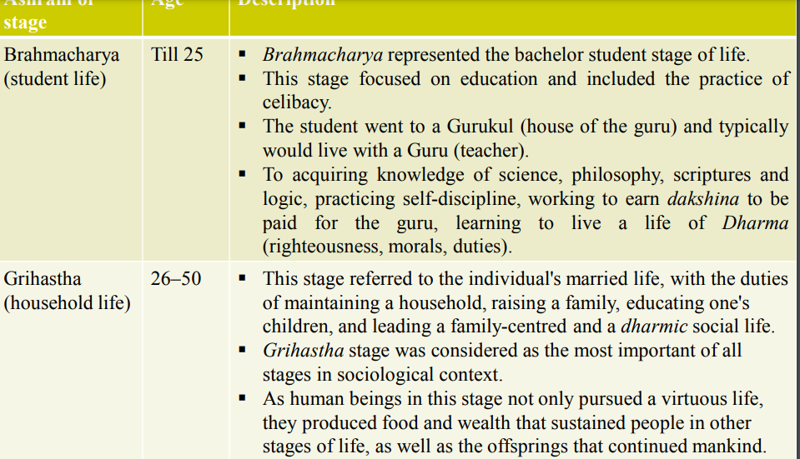
Ashrama or stages of life

Slide 48
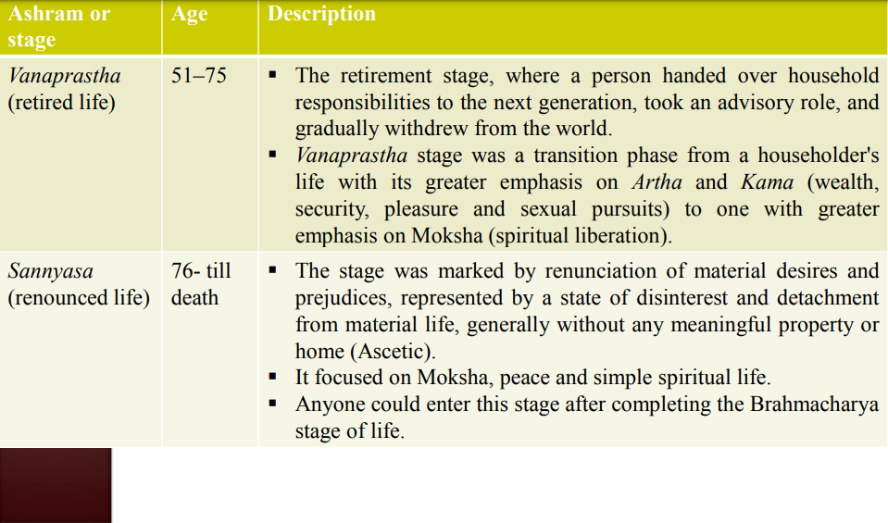
Ashrama or stages of life

Slide 49
Brahmacharya (ब्रह्मचर्य)
Brahmacharya (ब्रह्मचर्य) is a concept within Indian religions that literally means "conduct consistent with Brahma". In simple terms on the path of Brahma.
Brahmacharya is when a person controls his chitta, abstaining through word, thought, and deed from physical or sensual pleasures to achieve Brahmagyan.
Brahmacharya is the first of four Ashrama (age-based stages) of a human life.
Brahamacharya asrama occupied the first 20–25 years of life roughly corresponding to adolescence.
Upon the child's Upanayana the young person would begin a life of study in the Gurukula (the household of the Guru) dedicated to learning all aspects of dharma that is the "principles of righteous living"

Slide 50
Brahmacharya (ब्रह्मचर्य)
Dharma comprised personal responsibilities towards himself, family, society, humanity and God which included the environment, earth and nature. This educational period started when the child was five to eight years old and lasted until the age of 14 to 25 years
Naradaparivrajaka Upanishad suggests that Brahmacharya (student) stage of life should extend from the age a child is ready to receive teachings from a guru, and continue for a period of twelve years.
The Brahmacharya begin with Upanayana and ends with Samavartanam ceremony.
The graduate was then ready to either start Grihastha (householder) stage of life, or wait, or pursue a life of Sannyasa and solitude like Rishis in forest.

Slide 51
Grihastha (householder)
Grihastha literally means "being in and occupied with home, family" or "householder".
It refers to the second phase of an individual's life in a four age based stages of the Hindu ashram system.
It follows Brahmacharya (bachelor student) life stage, and embodies a married life, with the duties of maintaining a home, raising a family, educating one's children, and leading a family centred and a dharmic social life.

Slide 52
Grihastha (householder)
This stage of Ashrama is conceptually followed by Vanaprastha (forest dweller, retired) and Sannyasa (renunciation).
This stage of life was essential to completing the full development of a human being and fulfilling all the needs of the individual and society.
Ancient and medieval era texts of Hinduism consider Grihastha stage as the most important of all stages in sociological context, as human beings in this stage not only pursue a virtuous life, they produce food and wealth that sustains people in other stages of life, as well as the offsprings that continues mankind.

Slide 53
Grihastha (householder)
The householder stage is also considered in Indian philosophy as one where the most intense physical, sexual, emotional, occupational, social and material attachments exist in a human being's life.
In Indian traditions, Grihastha stage of life is a recommendation, but not a requirement.
Any Brahmacharya may, if he or she wants, skip householder and retirement stage, go straight to Sannyasa stage of life, thereby renouncing worldly and materialistic pursuits and dedicating their lives to spiritual pursuits.

Slide 54
Grihastha (householder)
The stage "Grihastha" is preceded by Brahmacharya (student) stage of life, and followed by Vanaprastha (retirement, forest dweller, still an advisor to the next generation) stage.
In ancient texts, Grihastha stage of life is said to extend from the age of about 25 to about 50.
A man or woman entered the Grihastha stage after a Hindu wedding.
They would build a home, raise a family, earn wealth, enjoy worldly life and participate in the society through virtues such as charity.

Slide 55
Vanaprastha (retired)
Vanaprastha literally means "giving up worldly life". It is also a concept in Hindu traditions, representing the third of four ashrama (stages) of human life.
Vanaprastha is part of the Vedic ashram system.
It starts when a person hands over household responsibilities to the next generation, takes an advisory role, and gradually withdraws from the world.
This stage typically follows Grihastha (householder), but a man or woman may choose to skip householder stage, and enter Vanaprastha directly after Brahmacharya (student) stage, as a prelude to San yasa (ascetic) and spiritual pursuits.

Slide 56
Vanaprastha (retired)
Vanaprastha stage is considered as a transition phase from a householder's life with greater emphasis on Artha and Kama (wealth, security, pleasure and sexual pursuits) to one with greater emphasis on Moksha (spiritual liberation).
The term Vanaprastha is a composite word with the roots vana meaning "forest, distant land", and prastha (प्रस्थ) meaning "going to, abiding in, journey to".
The composite word literally means "retiring to forest".
Vanaprastha represented the third stage and typically marked with birth of grandchildren, gradual transition of householder responsibilities to the next generation, increasingly hermit-like lifestyle, and greater emphasis on community services and spiritual pursuit.

Slide 57
Vanaprastha (retired)
The Vanaprastha stage ultimately transitioned into Sannyasa, a stage of complete renunciation and dedication to spiritual questions.
According to Vedic ashram system Vanaprastha lasted between the ages of 51 and 75
Hindu traditions respected freedom and personal choice.
While Grihastha and Vanaprastha stages of life were recommended, they were not a requirement.
Any Brahmacharya may, if he or she wants, skip householder and retirement stage, go straight to Sannyasa stage of life, thereby renouncing worldly and materialistic pursuits and dedicating their lives to spiritual pursuits

Slide 58
Vanaprastha (retired)
Markandeya Purana suggests that a householder, after he has taken care of his progeny, his parents, his traditions and cleansed his mind is ready to enter the third stage of life, or Vanaprastha.
He must lead a frugal life during this stage, sleeping on floor, eating only fruits and bulbs.
The more he gives up the worldly delights, the closer he gets to the knowledge of his spirit, and more ready he is for the last stage - the Sanyas Ashram, where he renounces everything and focuses entirely on spiritual pursuits.

Slide 59
Sannyasa (renunciate)
Sannyasa is the life stage of renunciation within the Hindu philosophy of four age-based life stages known as ashramas.
Sannyasa is traditionally conceptualized for men or women in late years of their life, but young brahmacharis have had the choice to skip the householder and retirement stages, renounce worldly and materialistic pursuits and dedicate their lives to spiritual pursuits.
An individual in Sanyasa is known as a Sannyasi (male) or Sannyasini (female) in Hinduism

Slide 60
Sannyasa (renunciate)
These are in many ways parallel to the Sadhu and Sadhvi traditions of Jain monasticism.
The bhikkhus and bhikkhunis of Buddhism.
Sannyasa has historically been a stage of renunciation, ahimsa (non-violence) peaceful and simple life and spiritual pursuit in Indian traditions.
Saṃnyāsa in Sanskrit: nyasa means purification, sannyasa means "Purification of Everything“
The term Saṃnyasa makes appearance in the Samhitas, Aranyakas and Brahmanas, the earliest layers of Vedic literature.
Hinduism has no formal demands nor requirements on the lifestyle or spiritual discipline, method or deity a Sanyasin or Sanyasini must pursue – it is left to the choice and preferences of the individual.
The goal of the Hindu Sannyasin is moksha (liberation).

Slide 61
Sannyasa (renunciate)
According to Gita permanent Sannyasin who does not hate, does not desire, is without dualities (opposites). Truly, Mahabaho (Arjuna), he is liberated from bondage.
Other behavioral characteristics, in addition to renunciation, during Sannyasa include: ahimsa (non-violence), akrodha (not become angry even if you are abused by others), disarmament (no weapons), chastity, bachelorhood (no marriage), avyati (nondesirous), amati (poverty), self-restraint, truthfulness, sarvabhutahita (kindness to all creatures), asteya (non-stealing), aparigraha (non-acceptance of gifts, non-possessiveness) and shaucha (purity of body speech and mind).

Slide 62
Daily Quiz
______ is the life stage of renunciation within the Hindu philosophy of four age-based life stages known as ashramas.
______ literally means "giving up worldly life".
______refers to the second phase of an individual's life in a four agebased stages of the Hindu ashram system.
Varnashrama Dharma is a Sanskrit name given to the _______ structure of the Indian society

Slide 63
Understanding Gender as a social category
Gender has been a central ‘issue’ in India since the colonial period.
The recognition of gender as an issue forms the basis for India’s women’s movement.
One important gender concern was a status that is, the rewards and benefits to women on India’ s journey to self-determination, statehood, democracy, progress, modernity, and development

Slide 64
The emergence of gender issues
Women’ s issues radically entered in the fields of culture, religion, and law; of family and community structures; of the problems of an official responses to population, poverty, illiteracy, and labor and of the new social movements of Dalits, environmentalists, tribal’s, anti-dam activists, peasants, and trade unions.
In feminist writings and in discourses on Gender Studies, these concepts are basic to our understanding of social differences between men and women in the society. A study of these concepts is useful as analytical categories.

Slide 65
Gender
Gender is a analytical category that is socially constructed to differentiate the biological difference between men and women.
The term gender is also used to describe the differences in behavior between men and women, which are described as masculine and feminine.

Slide 66
Gender and socialization
Socialization is the process, through which the child becomes an individual respecting his or her environment laws, norms and customs.
Gender socialization as the learning of behavior and attitudes considered appropriate for a given gender
The gender socialization process occurs in multiple social institutions, including the family, religious and educational institutions, mass media and peer networks.
Gender socialization is a more focused form of socialization, it is how children of different genders are socialized into their gender roles and taught what it means to be male or female.

Slide 67
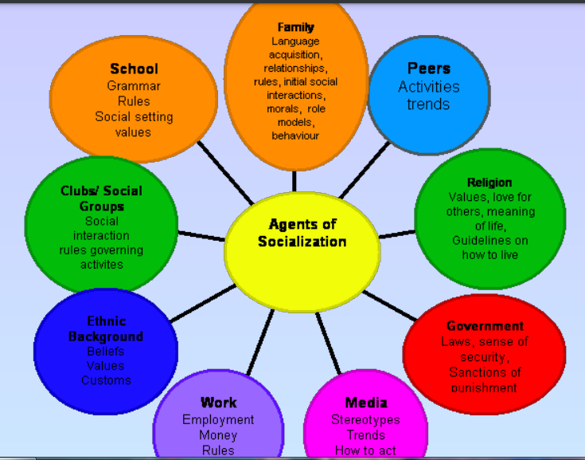
Agents of gender socialization

Slide 68
Family
From the perspective of children, the family is a family of orientation: the family functions to locate children socially, and plays a major role in their socialization.
From the point of view of the parent(s), the family is a family of procreation:
The family functions to produce and socialize children
Exogamy is a social arrangement according to which marriages can only occur with members outside of one’s social group.

Slide 69
School
The sociology of education is the study of how public institutions and individual experiences affect education and its outcomes.
A systematic sociology of education began with Émile Durkheim’s work on moral education as a basis for organic solidarity.
Socialization is the process by which the new generation learns the knowledge, attitudes and values that they will need as productive citizens.

Slide 70
Peers
The influence of the peer group typically peaks during adolescence.
However, peer groups generally only affect short term interests unlike the family, which has long term influence.
Peer groups can also serve as a venue for teaching members gender roles.
Adolescent peer groups provide support for children and teens as they assimilate into the adult society decreasing dependence on parents, increasing feeling of self-sufficiency, and connecting with a much larger social network.

Slide 71
Media
Language is a medium of socialization. A child learns the language of his or her culture and shapes his / her behavior in accordance with that culture.
The research studies indicates that men and women speak different gender lets. Women’s conversation have a cooperative character, where as men’s conversation’s are move competitive, less social and more individualistic.
Print Media and television also imparts a great role towards gender socialization.

Slide 72
Workplace
Employees with certain personality traits and experiences adjust to an organization more quickly. These include employees with a proactive personality, “Big Five” personality traits, curiosity, and greater experience levels.
Information seeking occurs when new employees ask questions of their co-workers to learn about the company’s norms, expectations, procedures and policies.

Slide 73
Religion
Sociology of religion is the study of the beliefs, practices, and organizational forms of religion using the tools and methods of the discipline of sociology.
Agents of socialization differ in effects across religious traditions. Some believe religion is like an ethnic or cultural category, making it less likely for the individuals to break from religious affiliations and be more socialized in this setting.

Slide 74
Daily Quiz
________as the learning of behavior and attitudes considered appropriate for a given gender
The term ______is also used to describe the differences in behavior between men and women
The sociology of ______ is the study of how public institutions and individual experiences affect education and its outcomes.
_______ is a medium of socialization.

Slide 75
Representation of Women in Indian History
The Indian woman's position in the society further deteriorated during the medieval period when Sati among some communities, Child Marriages and a ban on widow remarriages became part of social life among some communities in India.
The Muslim conquest in the Indian sub-continent brought the Purdah practice in the Indian society. Among the Rajputs of Rajasthan, the Jauhar was practised.
In some parts of India, the Devadasis or the temple women were sexually exploited. Polygamy was widely practised especially among Hindu Kshatriya rulers. In many Muslim families, women were restricted to Zenana areas. •
In spite of these conditions, some women excelled in the fields of politics, literature, education and religion.
Razia Sultana became the only woman monarch to have ever ruled Delhi

Slide 76
Representation of Women in Indian History
The Bhakti movements tried to restore women's status and questioned some of the forms of oppression. Mirabai, a female saint-poet, was one of the most important Bhakti movement figures.
Shortly after the Bhakti movement, Guru Nanak, the first Guru of Sikhs also preached the message of equality between men and women.
Raja Rammohan Roy's efforts led to the abolition of the Sati practice under Governor-General William Cavendish-Bentinck in 1829.
Ishwar Chandra Vidyasagar's crusade for the improvement in condition of widows led to the Widow Re-marriage Act of 1856.

Slide 77
Representation of Women in Indian History
Rani Lakshmi Bai the Queen of Jhansi, led the Indian Rebellion of 1857 against the British. She is now widely considered as a nationalist hero.
In 1917, the first women's delegation met the Secretary of State to demand women's political rights, supported by the Indian National Congress. The All India Women's Education Conference was held in Pune in 1927.
In 1929, the Child Marriage Restraint Act was passed, stipulating fourteen as the minimum age of marriage for a girl through the efforts of Mohammad Ali Jinnah. Though Mahatma Gandhi himself married at the age of thirteen, he later urged people to boycott child marriages and called upon the young men to marry the child widows.

Slide 78
Challenges faced by Women
Sati : The ritual of sitting on the funeral pyre of the husband and getting burnt to death is known as “Sati”. According to some Hindu scriptures, women dying as “Sati” go straight to heaven. Sati was considered to be a better option than living as a widow. Some of the scriptures like ‘Medhatiti’ had different views. It says that Sati is like committing suicide, so one should avoid this.
Jauhar: Jauhar was such a custom in Rajput societies where mass suicide occurred. In this custom Rajput women immolated themselves while their husbands were still alive. When a Rajput Sainik sure that they were going to die at the hands of their enemy, then all the women arrange a large pyre and set themselves afire, while their husbands used to fight the last decisive battle known as “Shaka”, with the enemy, thus protecting the sanctity of the women and the whole clan.

Slide 79
Challenges faced by Women
Child Marriage: Girls were married off at the age of 8-10 in Medieval India. They were not allowed access to education and were treated as the material being. Thus, women were compared with animals and were married off at an early age. Child marriage also brought some more problems such as-increased birth rate, poor health of women, high mortality rate of women and children.
Restriction on Widow Remarriage: The condition of widows in medieval India was very poor. They were treated as a material and for them a lot of restrictions were there. Their presence in any good work was strictly prohibited. They were not allowed to remarry. In medieval India, living as a Hindu widow was a sort of a curse.
Purdah System: The veil or ‘Purdah’ system was widely prevalent in medieval Indian society. It was used to protect them from the eyes of foreign rulers who invaded India in that period. But this system curtailed women’s freedom.

Slide 80
Challenges faced by Women
Women Education: The girls of Medieval India, specially Hindu society were not given formal education. They were given education related to household chores

Slide 81
Slavery System in India
Early sources suggest that slavery was likely to have been a widespread institution in ancient India by the lifetime of the Buddha (sixth century BC), and perhaps even as far back as the Vedic period.
Slavery in India escalated during the Muslim domination of northern India after the 11th-century, after Muslim rulers re-introduced slavery to the Indian subcontinent.
Slavery in India continued through the 18th and 19th centuries. During colonial times, Indians were taken into different parts of the world as slaves by the British East India Company, and the British Empire.Over a million indentured labourers also called girmitiyas from Uttar Pradesh and Bihar were taken as slave labourers to European colonies of British and Dutch in Fiji, South Africa, and Trinidad & Tobago.

Slide 82
Slavery System in India
The discussion of servant, bonded labor and slaves, states Scopen, differs significantly in different manuscripts discovered for the same Buddhist text in India, Nepal and Tibet, whether they are in Sanskrit or Pali language.
These Buddhist manuscripts present a set of questions to ask a person who wants to become a monk or nun. These questions inquire if the person is a dasa and dasi, but also ask additional questions such as "are you ahrtaka" and "are you vikritaka".
The later questions have been interpreted in two ways. As "are you one who has been seized" (ahrtaka) and "are you one who has been sold" (vikritaka) respectively, these terms are interpreted as slaves.
Alternatively, they have also been interpreted as "are you doubtless" and "are you blameworthy" respectively, which does not mean slave. Further, according to these texts, Buddhist monasteries refused all servants, bonded labor and slaves an opportunity to become a monk or nun, but accepted them as workers to serve the monastery

Slide 83
Video Link
Youtube/other Video Links:
https://youtu.be/1kUkWRnkEaY?list=PLhDPmw02TYsnl85_953po60uI_-R8CQY8
https://youtu.be/Hw6J5uOm7E8

Slide 84
Daily Quiz
1. Traditional approach give stress on:
  A. Values.
  B. Facts.
  C. Objectivity.
  D. Precision.
2. Hobbes Theory of Social Contract is explained in his book.
  A. Republic.
  B. Prince.
  C. Social Contract.
  D. Leviathan.
Which one of the following is not relevant to Traditional Approach.
A. Philosophical B. Historical. C. Institutional D. Behavioural.
4. Integration of Political Science with other Social Sciences Is a basic principle of
A. Traditionalism. B. Behaviouralism. C. Liberalism. D. Post – Behaviouralism.

Slide 85
Daily Quiz
6. The success of democracy depends upon
A. Periodic Elections. B. Voting. C. Campaigning in The Elections. D. All of the above
7. Who wrote the book ‘A Grammar of politics’
A. Laski
B. Hegal
C. J.S Mill
D T.H Green
8. The concept of Greek, ‘Justice’ was
A. Legal
B. Moral
C. Social
D. Political

Slide 86
Daily Quiz
9. The origin of democracy can be traced back to
A. Ancient Greek City States
B. Medieval Period
C. Modern Era
D. Feudalism

Slide 87
Assignment
Q.1Throw the light on force theory of ancient state.
Q.2 Discuss the evolutionary theory of ancient state
Q.3Throw the light on the Council of Ministers Administration Political Ideals in Ancient India Conditions’ of the Welfare of Societies.
Q.4Discuss the Seven Limbs of the State.

Slide 88
MCQ s
1. Who among the following said “Liberty is the opposite of over government”?
A. Seeley
B. Prof. Ramsay Muir
C. Laski
D. J.S Mill
2. What is meant by Social Justice.
A. All should have same Political Rights.
B. All should have same Economic rights.
C. All kinds of discrimination and privileges based on caste, colour, creed and sex should be eliminated.
D. All should have the right to freedom of religion.

Slide 89
MCQ s
3. Traditional approach give stress on:
A. Values.
B. Facts.
C. Objectivity.
D. Precision.
4. Hobbes Theory of Social Contract is explained in his book. A. Republic. B. Prince. C. Social Contract. D. Leviathan.
5. Which one of the following is not relevant to Traditional Approach.
A. Philosophical B. Historical. C. Institutional D. Behavioural.
6. Integration of Political Science with other Social Sciences Is a basic principle of
A. Traditionalism. B. Behaviouralism. C. Liberalism. D. Post – Behaviouralism.

Slide 90
MCQ s
7. Integration of Political Science with other Social Sciences Is a basic principle of
A. Traditionalism. B. Behaviouralism. C. Liberalism. D. Post – Behaviouralism.
8. The success of democracy depends upon
A. Periodic Elections. B. Voting. C. Campaigning in The Elections. D. All of the above
9. Who wrote the book ‘A Grammar of politics’
A. Laski
B. Hegal
C. J.S Mill
D T.H Green

Slide 91
MCQ s
10. The concept of Greek, ‘Justice’ was
A. Legal
B. Moral
C. Social
D. Political
11. The origin of democracy can be traced back to
A. Ancient Greek City States
B. Medieval Period
C. Modern Era
D. Feudalism

Slide 92
Glossary
Saptang, Kshatriyas, Ashram, Divine, Sati
______ theory is based on the notion that a god or multiple gods chose certain people to rule a civilization or group of people.
An ______ in Hinduism is one of four age-based life stages discussed in Indian texts of the ancient and medieval eras.
The ritual of sitting on the funeral pyre of the husband and getting burnt to death is known as “Sati”.
_____ were those people who belonged to the clan of the kings and soldiers and used to look after the safety of their territory and the people.
______ theory of state was given by Kautilya in Arthashastra.

Slide 93
Old Question papers
Subject was introduced last year for the first time and exam was in Online mode.

Slide 94
Expected Questions for University Exam
Q.1Throw the light on force theory of ancient state.
Q.2 Discuss the evolutionary theory of ancient state
Q.3Throw the light on the Council of Ministers Administration Political Ideals in Ancient India Conditions’ of the Welfare of Societies.
Q.4Discuss the Seven Limbs of the State.

Slide 95
Summary
This unit gives overview on how states were formed and various theories attached to it. Also it gives a clear insight into different Ashrams in Hindu Concept.

Slide 96
References
References :
1. V. Sivaramakrishna (Ed.), Cultural Heritage of India-Course Material, Bharatiya Vidya Bhavan, Mumbai, 5th Edition, 2014
2. S. Baliyan, Indian Art and Culture, Oxford University Press, India
3. Swami Jitatmanand, Modern Physics and Vedant, Bharatiya Vidya Bhavan
4. Romila Thapar, Readings In Early Indian History Oxford University Press , India
Source: www.aktuonline.org

